Slide 1
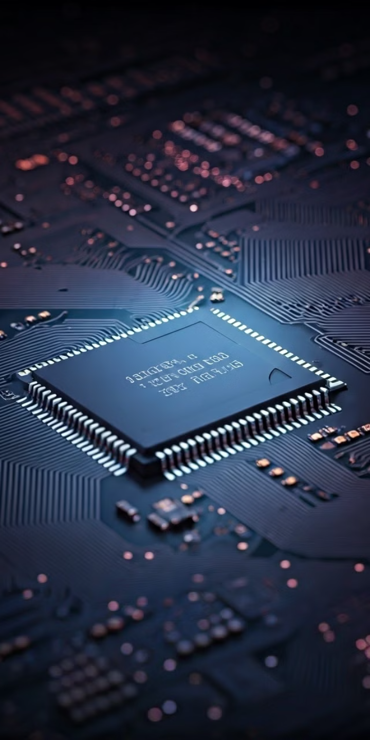

Multiple Patterning Lithography
Multiple patterning lithography (MPL) is a critical technology used to create intricate and highly dense features on semiconductor wafers, enabling the continuous scaling of transistors and other critical components in integrated circuits.
by 峰 喬

Slide 2

Challenges in Semiconductor Scaling
1
Resolution Limits
2
Cost and Complexity
As transistors shrink, traditional lithographic techniques struggle to resolve features with sufficient accuracy and precision.
The development and manufacturing of next-generation lithographic tools becomes increasingly expensive and complex, posing significant challenges for the industry.
3
Process Variability
4
Pattern Density
Smaller features are more susceptible to variations in manufacturing processes, leading to inconsistent device performance and yield issues.
The need for increasingly dense patterns to pack more transistors on a chip requires sophisticated techniques to create complex and intricate features.

Slide 3
Principles of Multiple Patterning
1
Pattern Division
The desired complex pattern is divided into multiple simpler patterns that can be individually printed using lithography.
2
Exposure and Development
Each simpler pattern is exposed and developed on the wafer in a sequence of steps, utilizing different masks or exposure techniques.
3
Pattern Transfer
The multiple patterns are then transferred into the underlying material, such as silicon, using etching or other processing techniques.
4
Final Pattern Formation
The final, complex pattern is formed by the overlapping and integration of the individual patterns created in previous steps.

Slide 4
Double Patterning Techniques
193nm Immersion Lithography
Two-Mask Approach
Pattern Transfer
Double patterning leverages the resolution of 193nm immersion lithographic tools to create smaller features than would be possible with a single exposure.
Two different masks are used to create two separate patterns, which are then overlaid and aligned with high accuracy to form the final desired feature.
The patterned features are transferred into the underlying material using etching, deposition, or other suitable techniques.

Slide 5
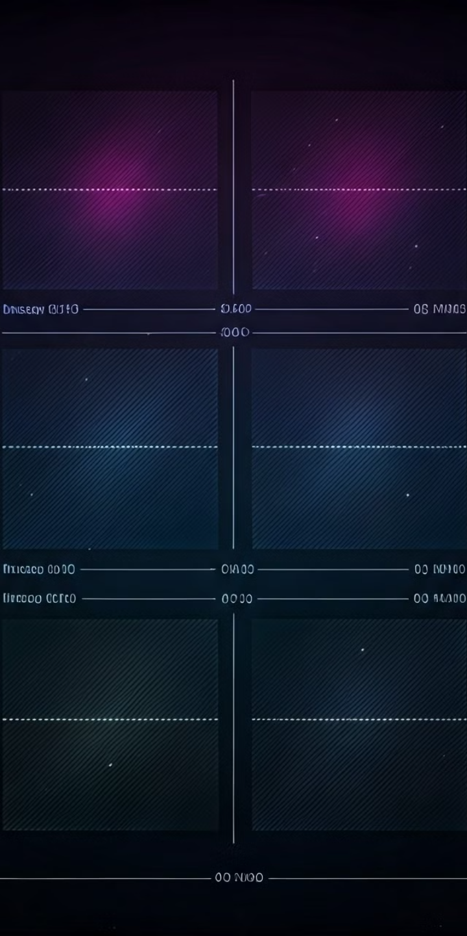



Quadruple Patterning Techniques
Multiple Exposures
Quadruple patterning utilizes four separate exposures to create four different patterns on the wafer.
Mask Alignment
Each exposure requires precise alignment with the previous patterns, ensuring the accurate placement and registration of the features.
Pattern Merging
The four individual patterns are then merged and integrated to form the final complex pattern on the wafer.

Slide 6
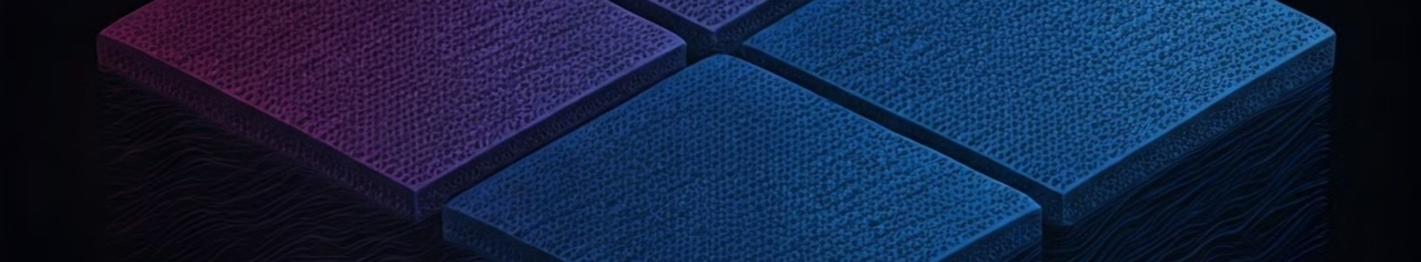
Self-Aligned Quadruple Patterning (SAQP)
SAQP
Reduces the number of masks required for quadruple patterning, simplifying the process and reducing costs.
Self-Alignment
SAQP uses a single mask and a series of processing steps to achieve accurate alignment without requiring precise mask-to-mask alignment.
Pattern Transfer
SAQP involves multiple exposure, development, and etching steps to create and transfer the final pattern onto the wafer.

Slide 7
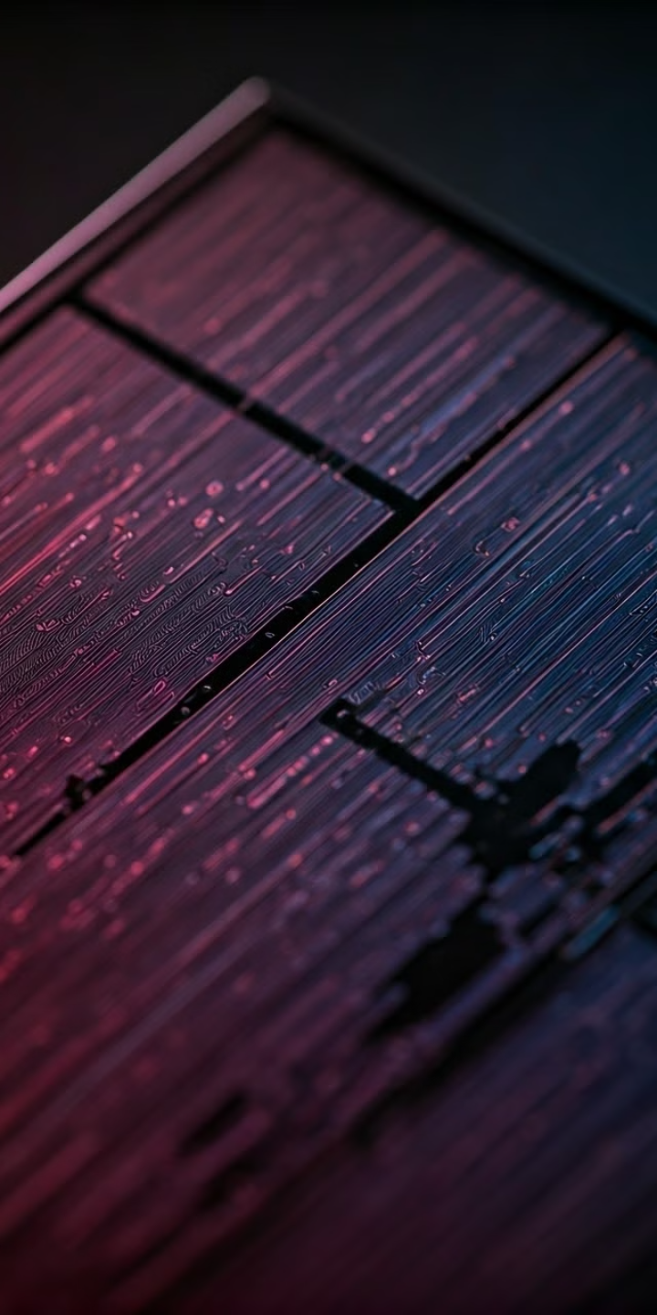
Mask Design and Layout Considerations
Feature Size and Shape
Pattern Overlap and Merging
The design of the mask must accurately reflect the desired feature size and shape, taking into account the resolution limits of the lithographic process.
The mask must be designed to ensure proper overlap and merging of multiple patterns to create the final desired features.
Mask Complexity and Fabrication
Yield and Defect Control
The mask design should be optimized to minimize potential defects and maximize yield, ensuring the reliable production of high-quality devices.
The complexity of the mask design can significantly impact the fabrication process, requiring advanced techniques and tooling.

Slide 8
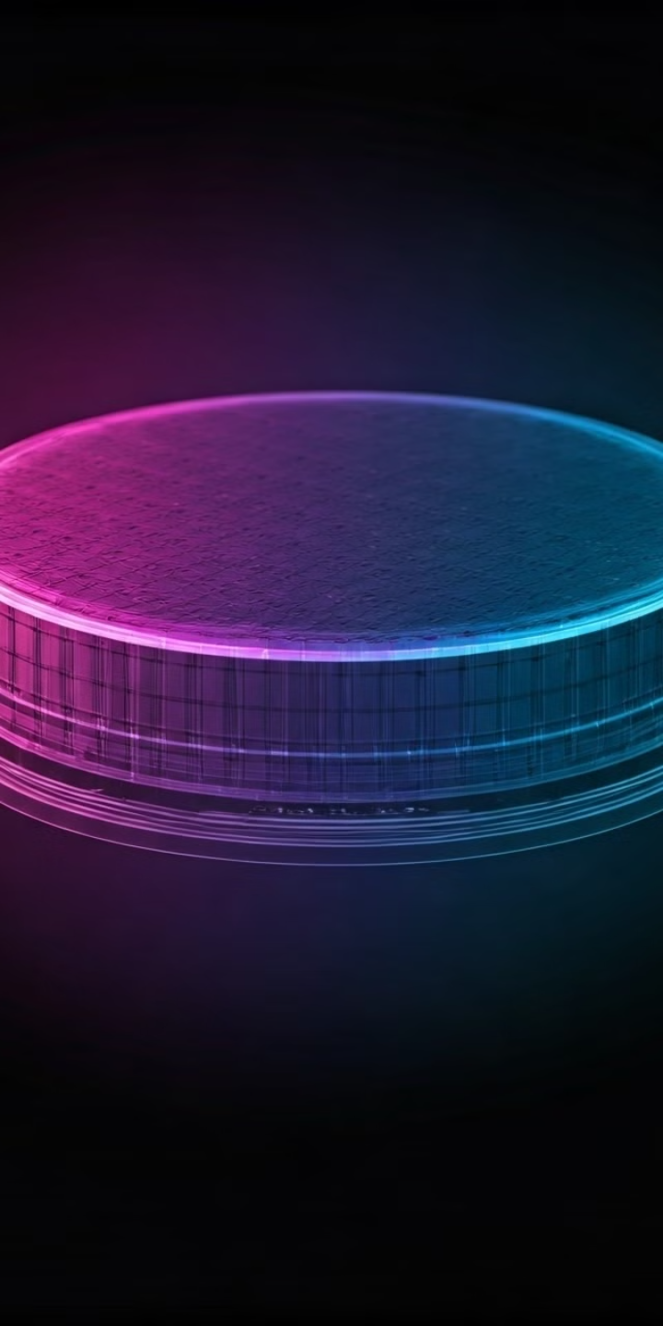




Overlay and Alignment Challenges
Sub-nanometer Accuracy
Precision Alignment
Overlay and alignment must be achieved with sub-nanometer accuracy to ensure that multiple patterns align perfectly, particularly for smaller features.
Advanced alignment systems and metrology tools are essential to achieve the required precision and accuracy in pattern placement.
Distortion and Wafer Bow
Temperature Control
Wafer distortion and bow can introduce significant challenges in achieving accurate overlay, requiring advanced compensation techniques.
Maintaining a stable temperature environment is crucial to minimize thermal expansion and distortion effects on the wafer, ensuring accurate alignment.

Slide 9
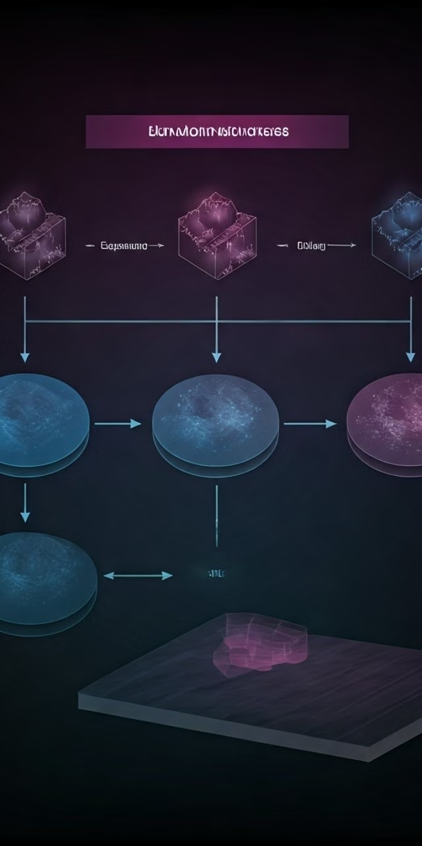
Process Integration and Optimization
1
Process Development
Extensive process development is required to optimize the individual steps and ensure seamless integration of multiple patterns.
2
Process Control
Rigorous process control is essential to maintain consistent performance and yield, minimizing variations in the final pattern quality.
3
Defect Reduction
Optimizing process steps and implementing defect inspection techniques can help reduce defects and improve overall yield.
4
Cost Optimization
Balancing performance with cost is critical, exploring alternative techniques or process modifications to reduce manufacturing costs.

Slide 10
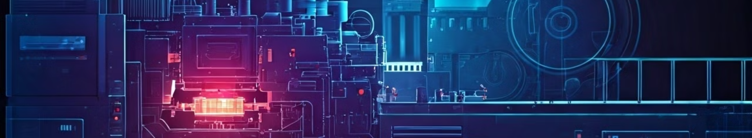
Future Trends and Advancements
1
Extreme Ultraviolet Lithography (EUV)
2
Directed Self-Assembly (DSA)
EUV lithography is a promising technology for achieving smaller feature sizes, potentially eliminating the need for multiple patterning.
DSA techniques leverage self-assembly principles to create complex patterns with higher resolution, potentially simplifying the lithography process.
3
Hybrid Approaches
4
Artificial Intelligence (AI)
Combining multiple patterning with EUV or DSA techniques may offer advantages in terms of resolution, throughput, and cost.
AI algorithms are increasingly being used to optimize process parameters and predict device performance, leading to more efficient and effective manufacturing.

